Slide 1

Hyperparameter tuning
Tuning process
deeplearning.ai

Slide 2
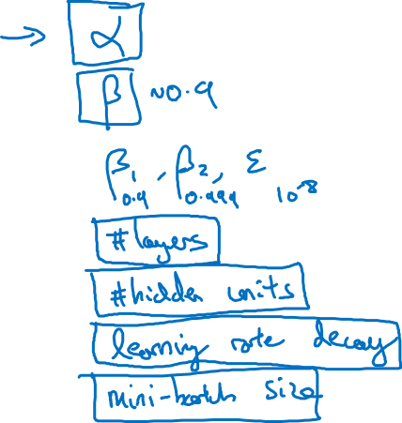
Hyperparameters

Slide 3
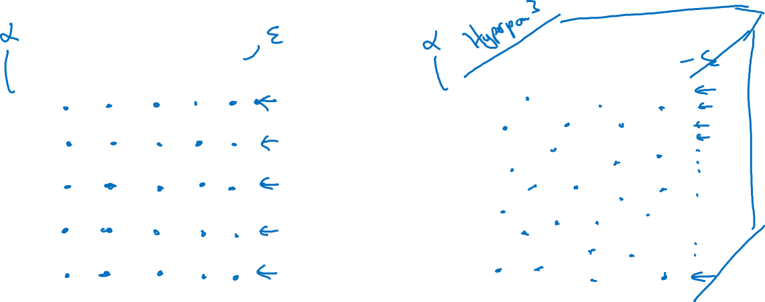
Try random values: Don’t use a grid
Hyperparameter 2
Hyperparameter 2
Hyperparameter 1
Hyperparameter 1

Slide 4
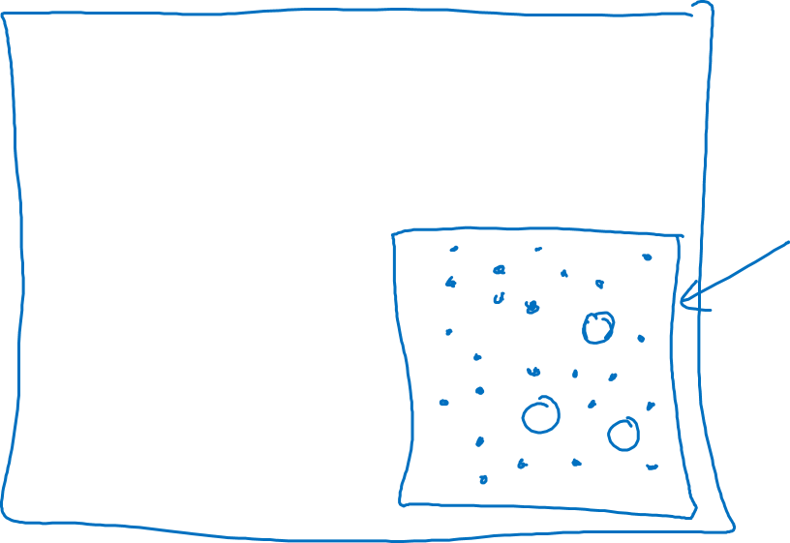
Coarse to fine
Hyperparameter 2
Hyperparameter 1

Slide 5
Hyperparameter tuning
Using an appropriate scale to pick hyperparameters
deeplearning.ai

Slide 6
Picking hyperparameters at random

Slide 7
Appropriate scale for hyperparameters

Slide 8
Hyperparameters for exponentially weighted averages

Slide 9
Hyperparameters tuning
Hyperparameters
tuning in practice:
Pandas vs. Caviar
deeplearning.ai

Slide 10


Re-test hyperparameters occasionally
Idea
NLP, Vision, Speech,
Ads, logistics, ….
Intuitions do get stale. Re-evaluate occasionally.
Experiment
Code

Slide 11
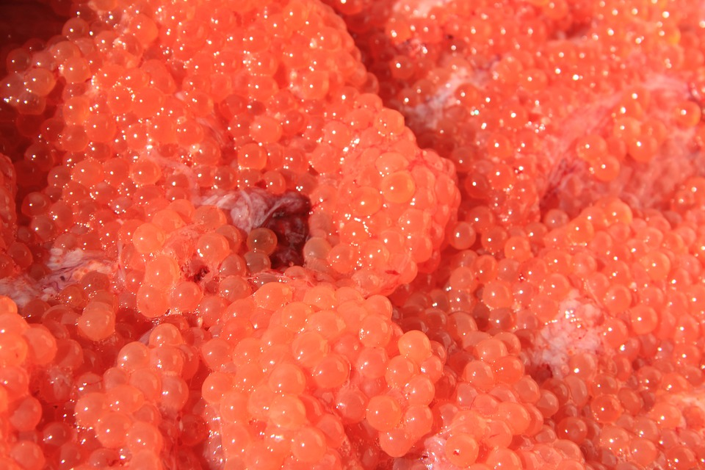
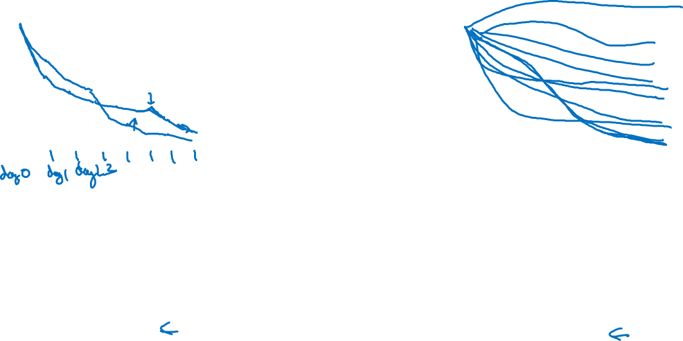
Babysitting one model
Training many models in parallel
Panda
Caviar

